Slide 1
Programming Fundamentals
BY
Adnan Amin
Lecturer, IMSciences, Peshawar

Slide 2
Functions in Python

Slide 3
Functions
A function is a group of statements that exist within a program for the purpose of performing a specific task.
For Example:
A function that gets the employee’s gross pay.
A function that calculates the sum of the numbers.
A function that calculates the subtraction of the numbers.

Slide 4
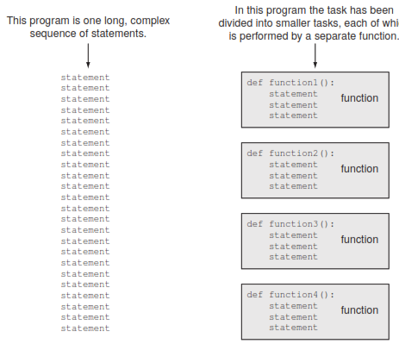
Using functions to divide and conquer a large task

Slide 5
Benefits of Modularizing a program with Functions
Simpler Code
Code reuse
Faster development
Easier facilitation of teamwork
Better testing

Slide 6
Basic Terminologies
Function name
Function definition
Calling a function
Void function

Slide 7
Function name
Just as you name the variables that you use in a program, you also name the functions.
Rules for function name:
Cannot use python’s keywords.
Cannot contain spaces.
First character must be a-z or A-Z or underscore.
After first character you may use digits.
Case sensitive

Slide 8
Function definition
The code for a function is known as a function definition.
To create a function you write its definition.
def function_name( ):
Statement 1
Statement 2
Statement N
Def hello( ):
print(“ Hello Students”)

Slide 9
Calling a function
A function definition specifies what a function does, but it does not cause the function to execute.
To execute a function, you must call it.
Hello( )
When a function is called, the interpreter jumps to that function and executes the statements in its block. Then, when the end of the block is reached, the interpreter jumps back to the part of the program that called the function, and the program resumes execution at that point.

Slide 10
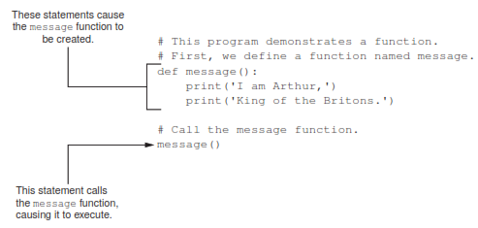

Slide 11
Demostration
# function definition
def hello( ):
print(‘Hello Students’);
# Calling a function
Hello( )

Slide 12
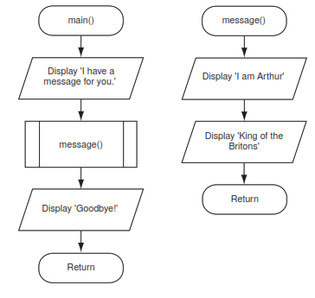
Flowchart for a program that contain a function

Slide 13
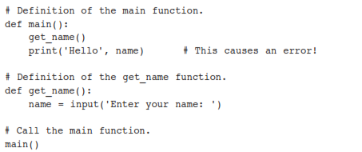
Local Variables
A local variable is created inside a function and cannot be accessed by statements that are outside the function.
Different functions can have local variables with the same names because the functions cannot see each other’s local variables.

Slide 14
Scope of a variable
A variable’s scope is the part of a program in which the variable may be accessed.
A variable is visible only to statements in the variable’s scope.
A local variable’s scope is the function in which the variable is created.
No statement outside the function may access the variable.
A parameter variable’s scope is the function in which the parameter is used.

Slide 15
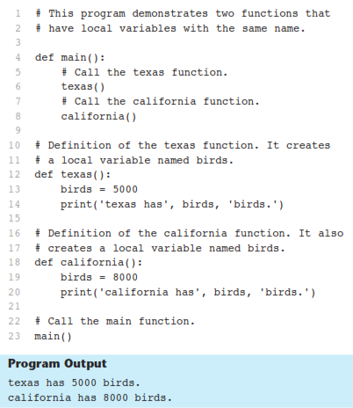

Slide 16
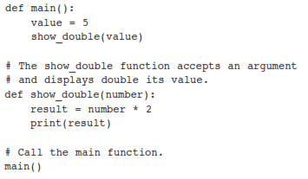
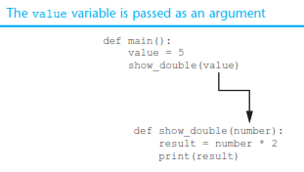
Passing argument to a functions
An argument is any piece of data that is passed into a function when the function is called.
A parameter is a variable that receives an argument that is passed into a function.

Slide 17
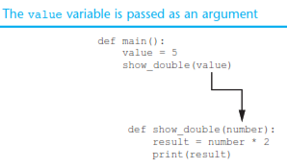
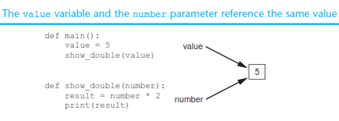

Slide 18

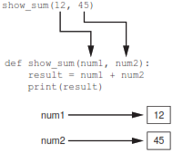
Passing Multiple Arguments
show_sum(12, 45)

Slide 19

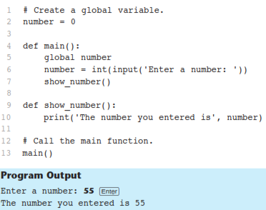

Global Variables and Global Constants
A global variable is accessible to all the functions in a program file.

Slide 20

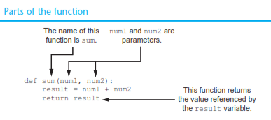

Value-Returning Functions
A value returning function has a return statement that returns a value back to the part of the program that called it.

Slide 21
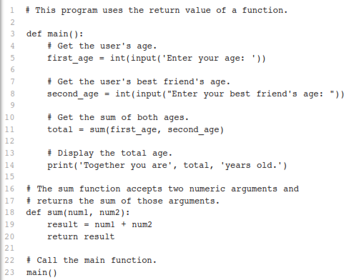
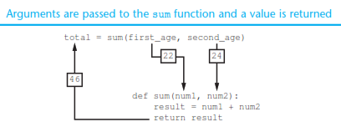


Slide 22
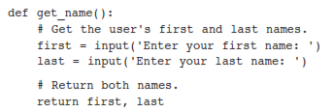

Returning Multiple Values

